Slide 1



Physics and Control of Shock Boundary Layer Interaction
April 16, 2016
University of Arizona LPL 330
Aeronautics Symposium
Ethan Beyak
Mentor: Dr. Jesse Little

Slide 2
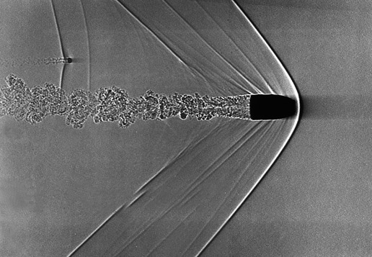
Background: Shock Waves
Shock waves are abrupt changes in the fluid properties typically caused by geometric variations in high speed flows.
Flow slows down across the shock to turn.
As Mach number increases, the strength of the shock decreases
Flow
http://www.nasa.gov/mission_pages/galex/20070815/f.html

Slide 3
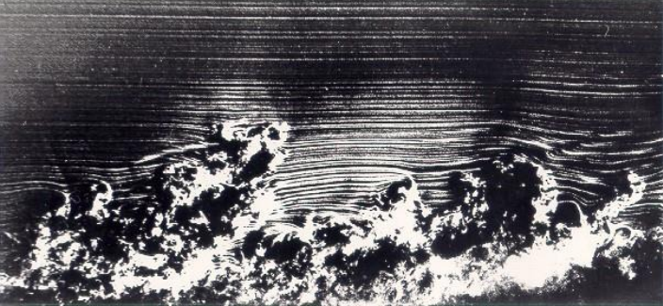
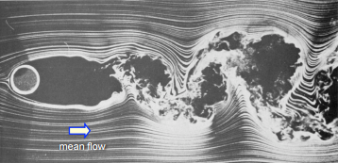
Background: Boundary Layers & Separation
A boundary layer (BL) is the region of slow flow adjacent to a surface.
Flow separates when there is not enough momentum in the boundary layer to overcome the pressure gradient and friction from the wall.
Turbulent Boundary Layer Snapshot
Separated Flow & Turbulent Wake
Van Dyke, 1982, An Album of Fluid Motion

Slide 4
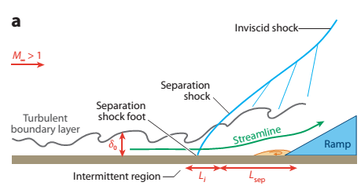
Background: Shock Boundary Layer Interaction
Across an oblique shock, the flow slows down to turn; there is an adverse pressure gradient.
If the shock is strong enough, this may cause the BL to separate.
Separated BLs form small regions of subsonic flow which possess low-frequency unsteadiness.
Clemens and Narayanaswamy, Annual Review of Fluid Mechanics, 2014

Slide 5
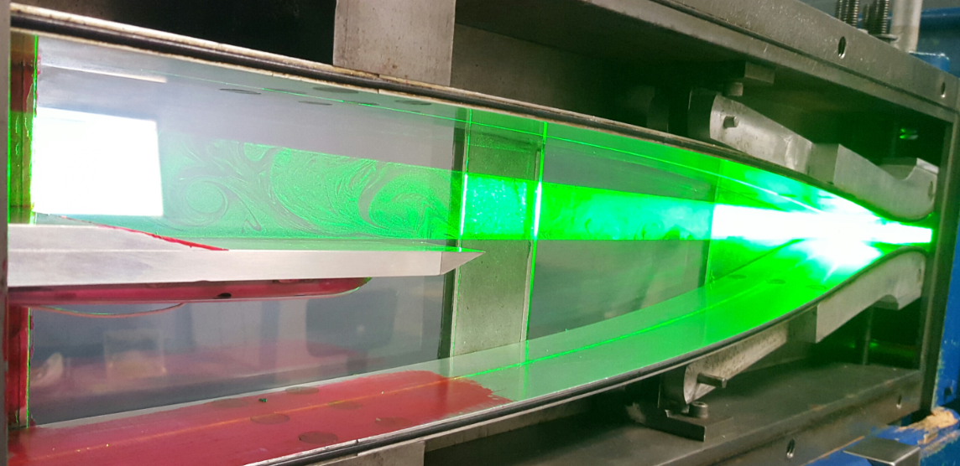
Methods: Particle Imaging Velocimetry
Also known as PIV
Fill room with smoke particles, illuminate test section with a laser, then a high-resolution camera takes pictures in rapid succession, revealing velocity field and other characteristics about the shock and the boundary layer
Original content, 2015

Slide 6
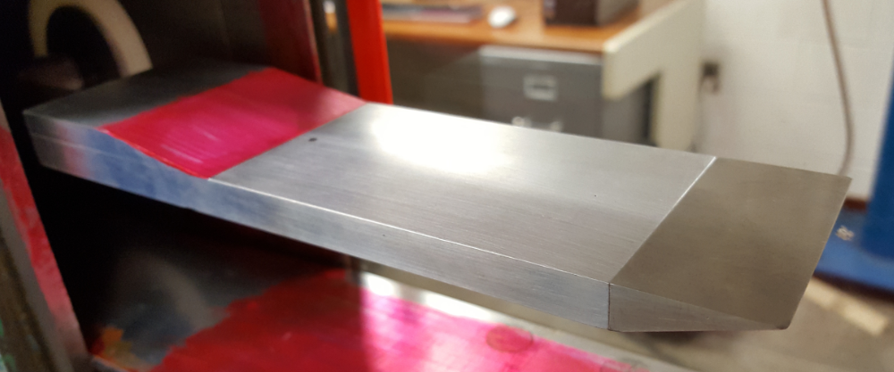
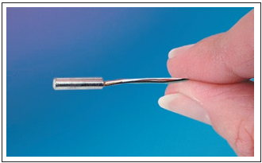
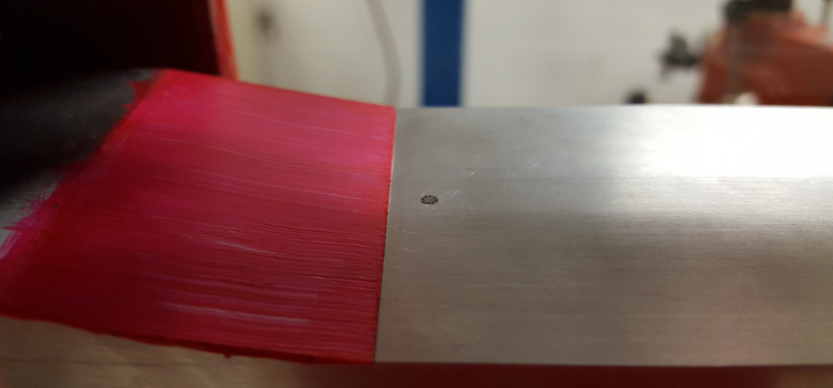
Methods: Kulite Pressure Sensor
Kulite sensors measure pressure fluctuations, which reveal characteristic frequencies of the flow.
From Datasheet: Kulite Miniature Pressure Transducer, XCQ-093 Series
Original content, 2016

Slide 7
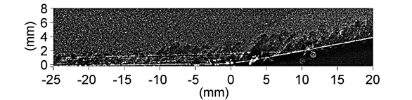
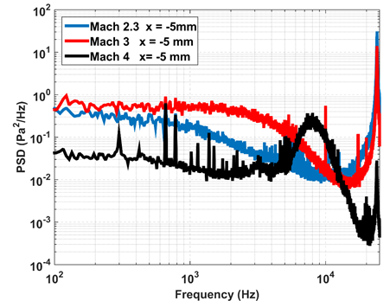
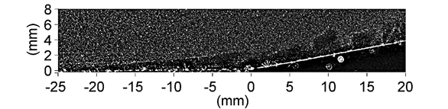
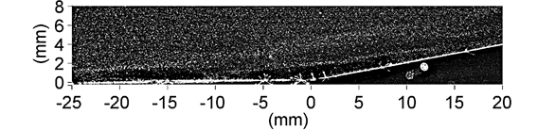
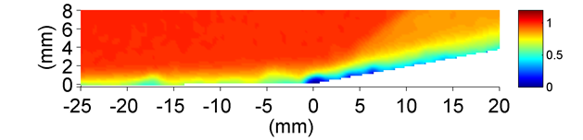
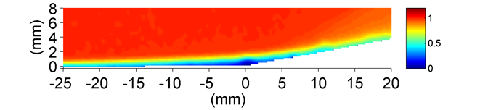
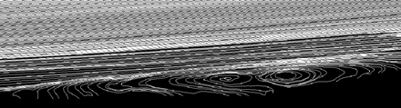
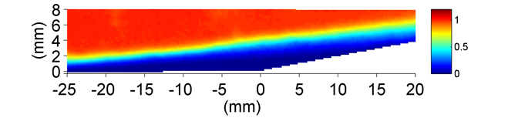
Results
Mach 2.3
Mach 3
Mach 4
Mach 2.3
Mach 3
Mach 4 Streamlines
Mach 4

Slide 8
Acknowledgements
Dr. Jesse Little, Robyn Dawson, Ruben Adkins, Ilona Stab
All of Dr. Little’s graduate students
AFOSR and Raytheon
Aerospace & Mechanical Engineering Department
Space Grant Symposium

Slide 9


Thank You

